Slide 1
Snake game

Slide 2

TEAM MEMBERS
Naren Karthikeyan B (2022506133)
Ravishankar S (2022506110)
Anselm Flavian P (2022506101)
Tamil Selvan V (2022506070)
Nelson Bharathi A (202250608_)

Slide 3
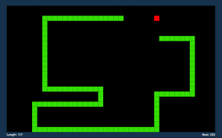
INTRODUCTION
Snake game is a classic arcade game where the player controls a snake that moves around the screen, eating fruit and growing longer.
The objective of the game is to around running into the walls or the snake’s own body.
The goal of the game is to achieve as high of a score as possible.

Slide 4
Modules and packages used
Package: Pygame
Modules: random, sys
Modules imported from pygame: pygame.math, pygame.locals

Slide 5
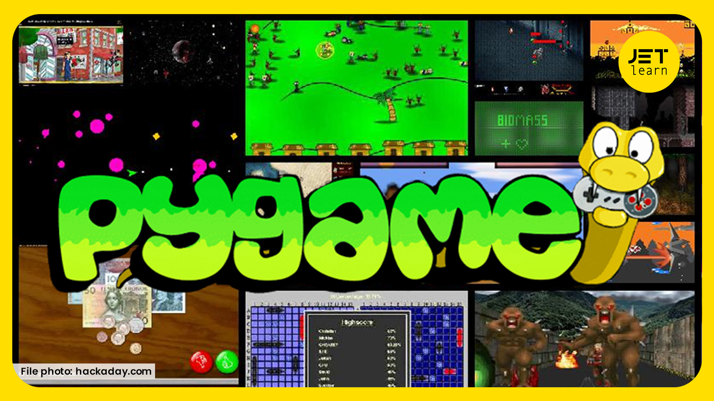
PYGAME PACKAGE
Pygame is a powerful package that helps us to build 2-d games with graphics. It has inbuilt modules to handle sound, image and text.
One important advantage of this package is that its learning curve is not that steep. It is beginner friendly and features rich.

Slide 6
MODULES IMPORTED FROM PYGAME
Pygame.math module:
We have used this module to use Vector2(2 dimensional vector) data structure. As our game involves a lot of vector operations, this module has proven to be extremely useful for us. We can retrieve the coordinates of this data structure by using:
a = Vector2(2,3)
Then coordinates of ‘a’ can be used by a.x and a.y for x and y coordinates respectively.
Other modules like Pygame.display, Pygame.time, Pygame.image, Pygame.font and Pygame.mixer are used. These will be explained in the code explanation section.

Slide 7
MODULES IMPORTED FROM PYGAME
Pygame.locals
We have used this module to simply get the attributes for keydown, upper arrow key, lower arrow key, left and right arrow key and finally escape key.
Here,
KEYDOWN – a type of event that registers a pressed key
K_UP – upper arrow key K_LEFT – left arrow key
K_DOWN – down arrow key K_RIGHT – right arrow key
K_ESCAPE – escape key
These keys are possible values of event.key.

Slide 8
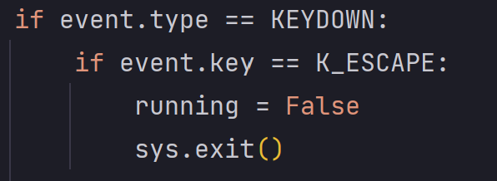
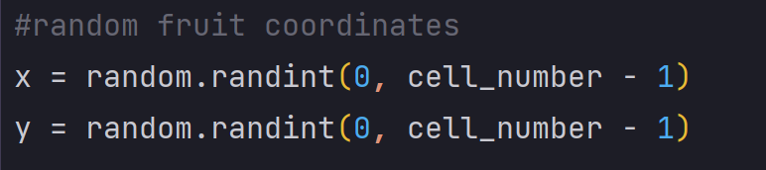
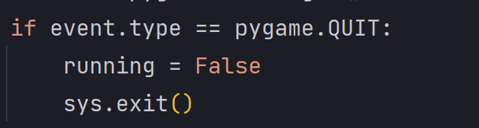
MODULES
Random module:
We have used the randint function of this module to randomise the fruit’s position whenever it gets hit by a snake.
Sys module:
We have used the exit function of this module. This ensures that any background activity stops if close button or escape button is pressed

Slide 9
SOURCE CODE

Slide 10
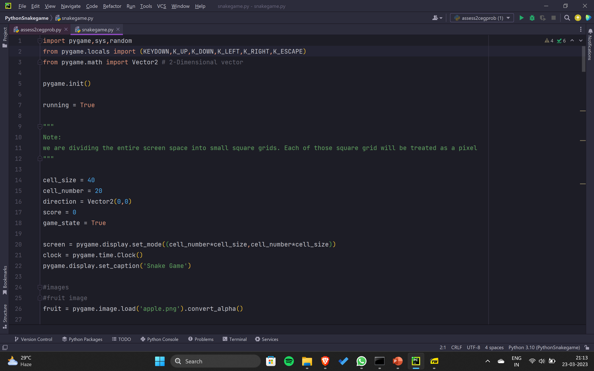
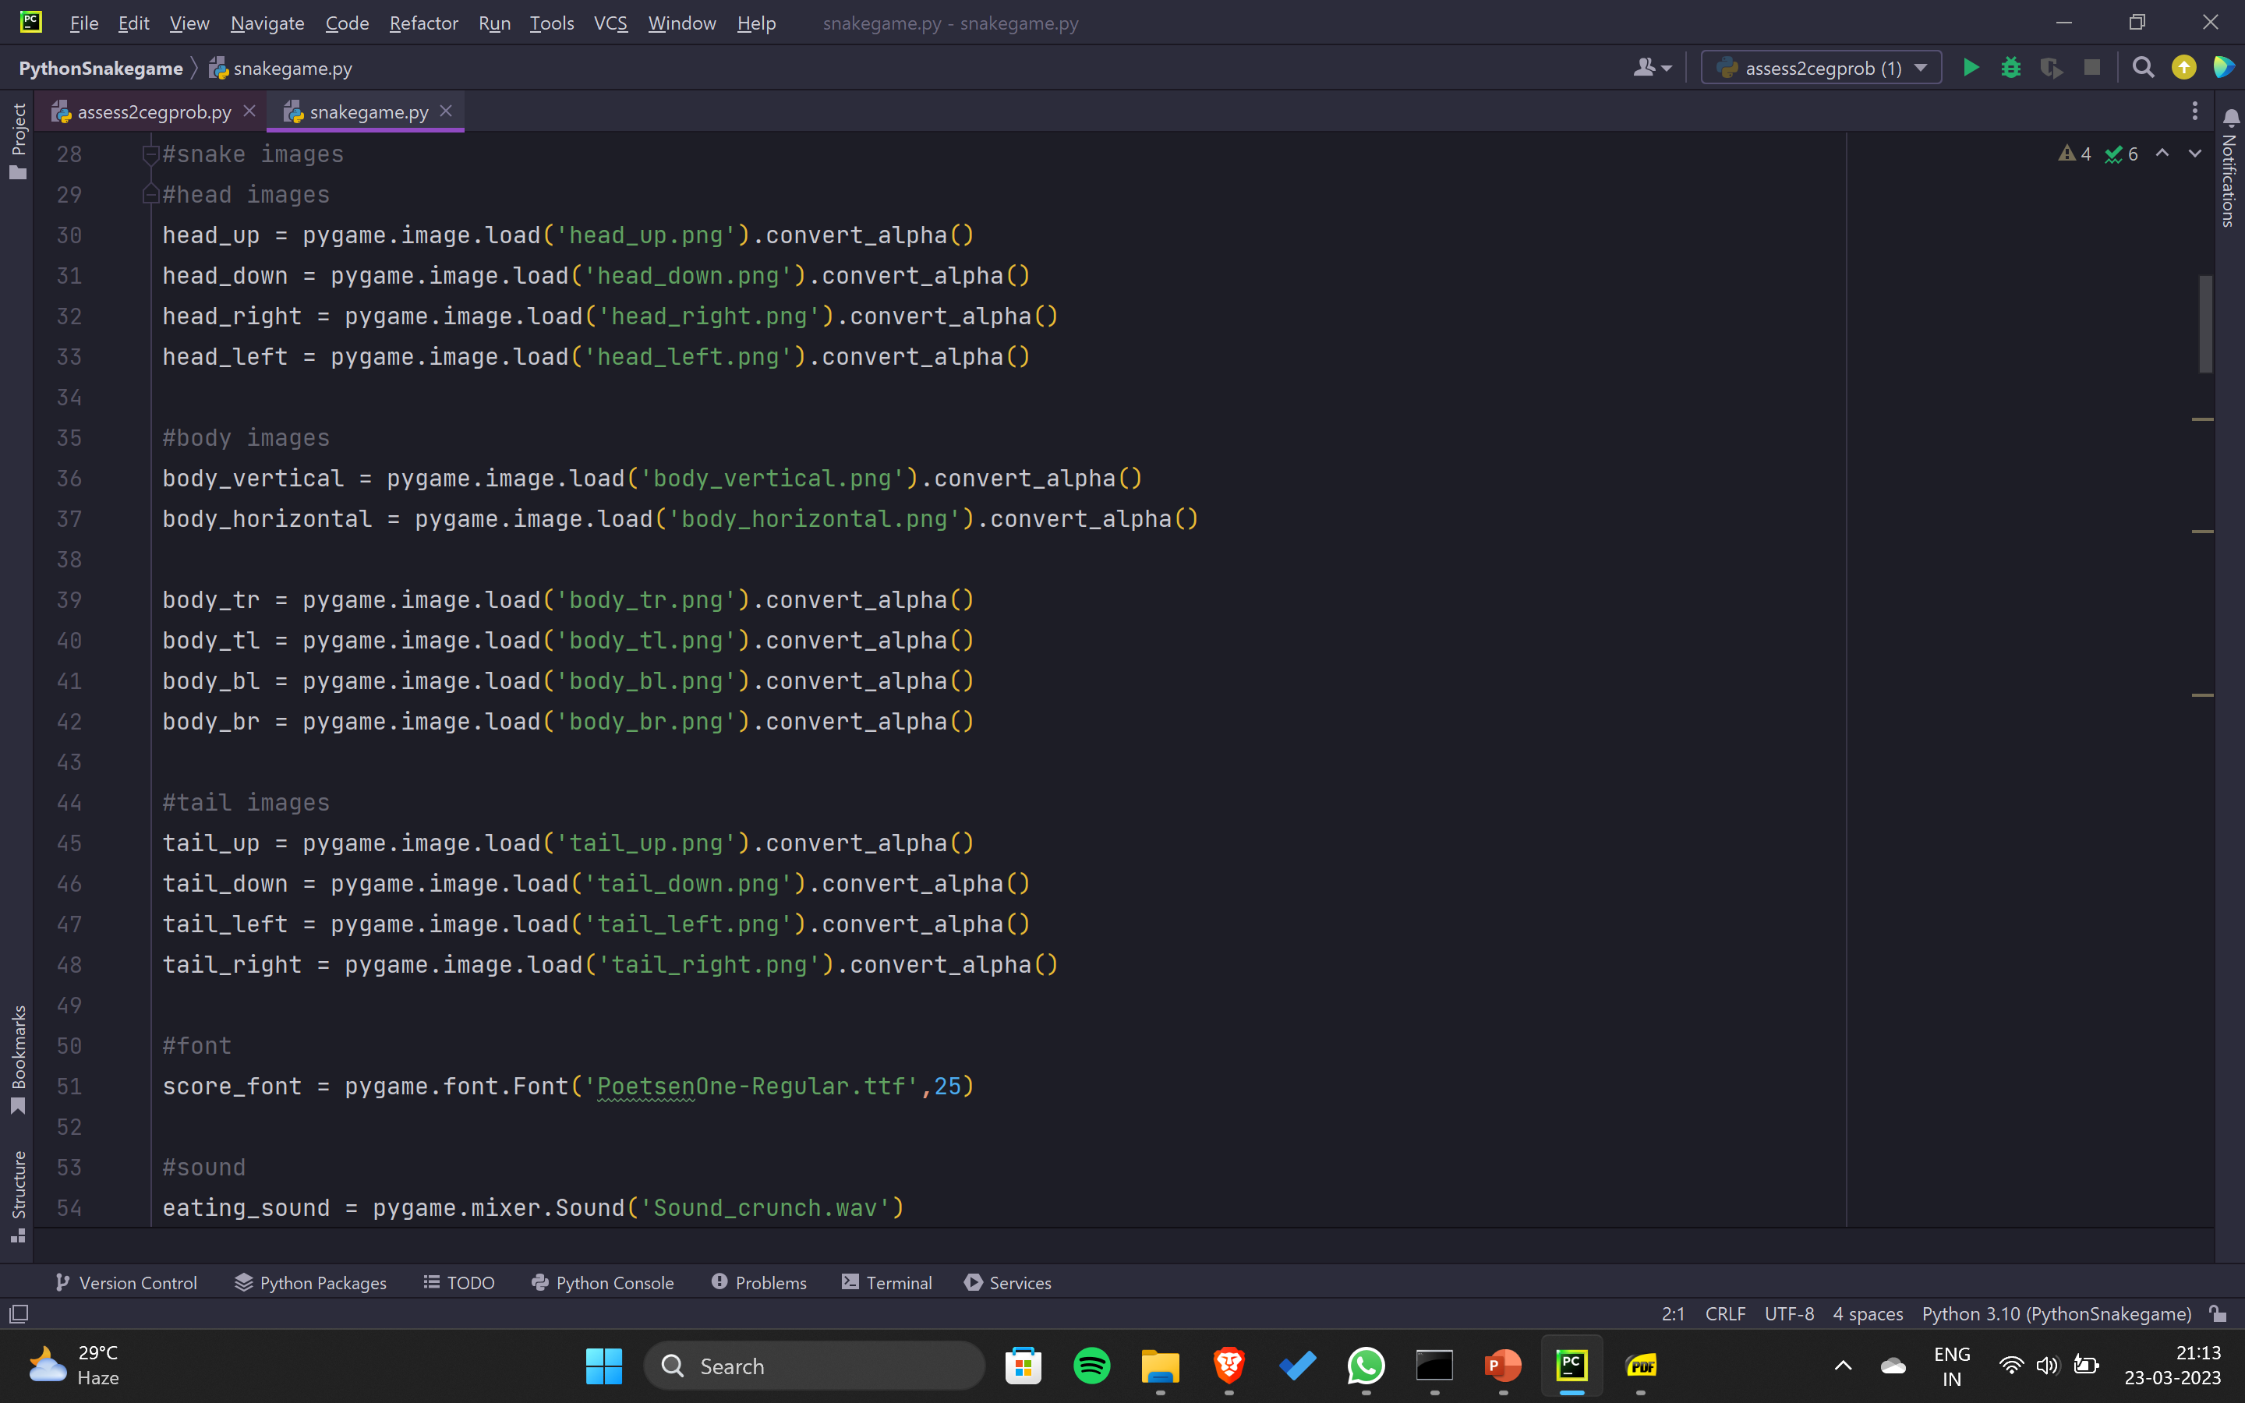

Slide 11
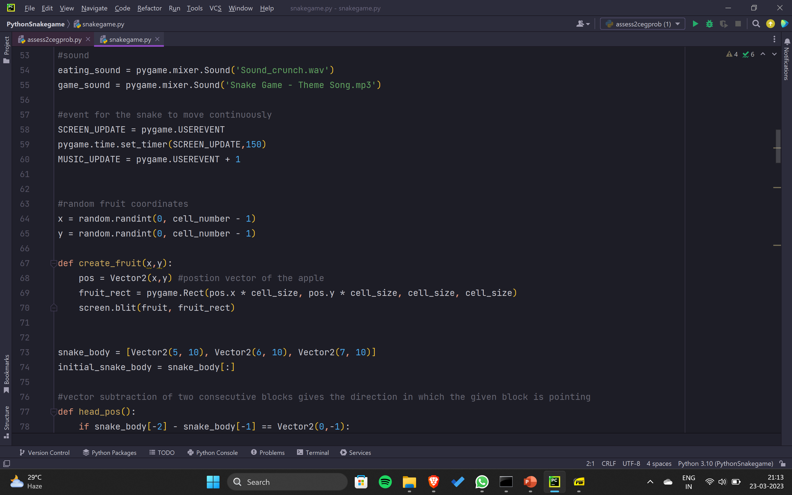
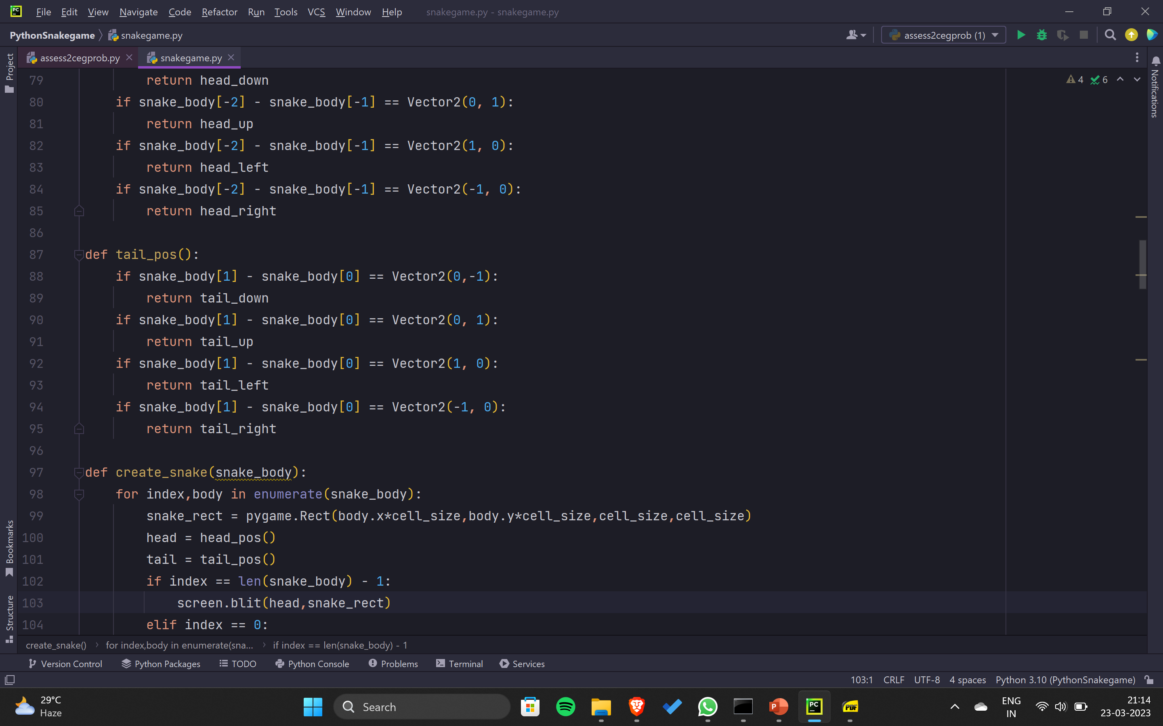

Slide 12
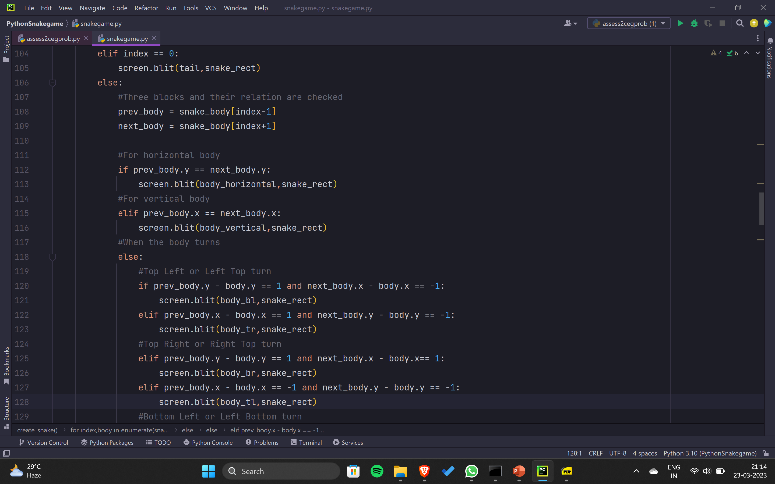
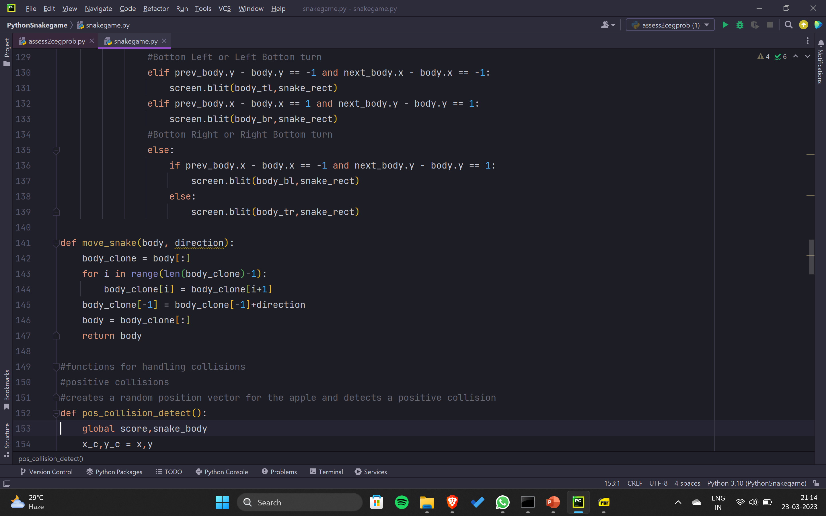

Slide 13
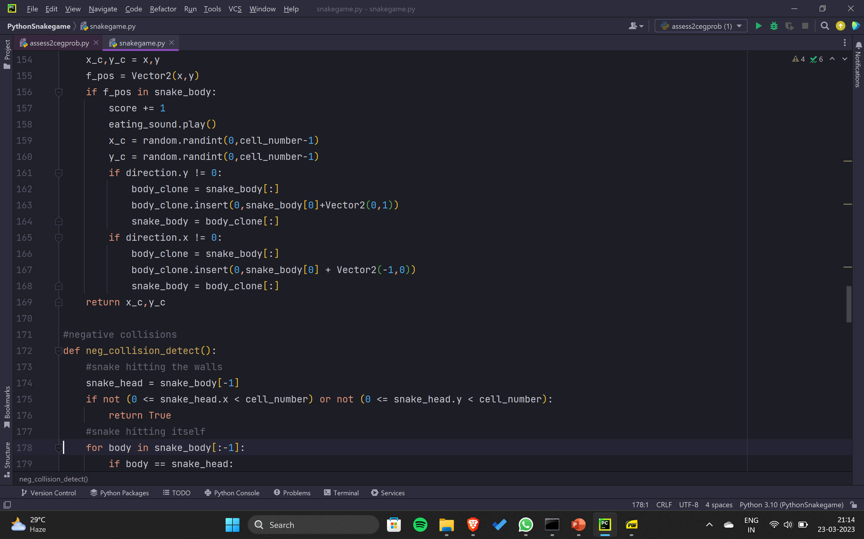
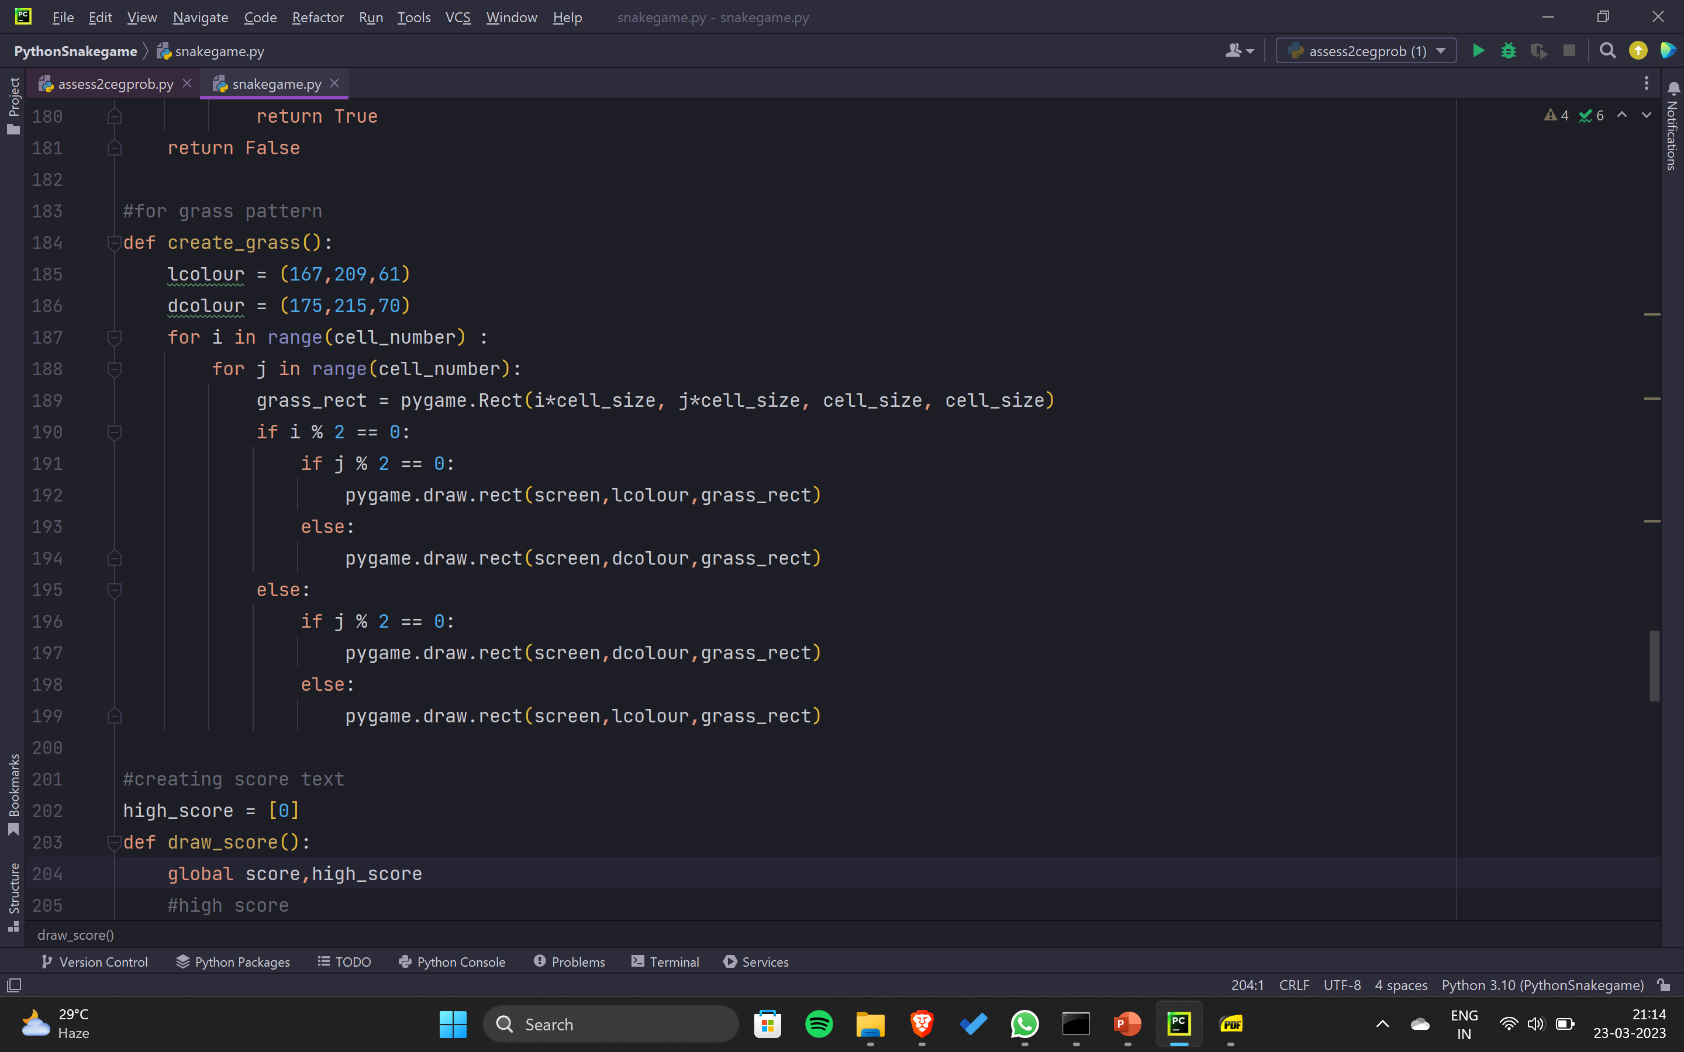

Slide 14
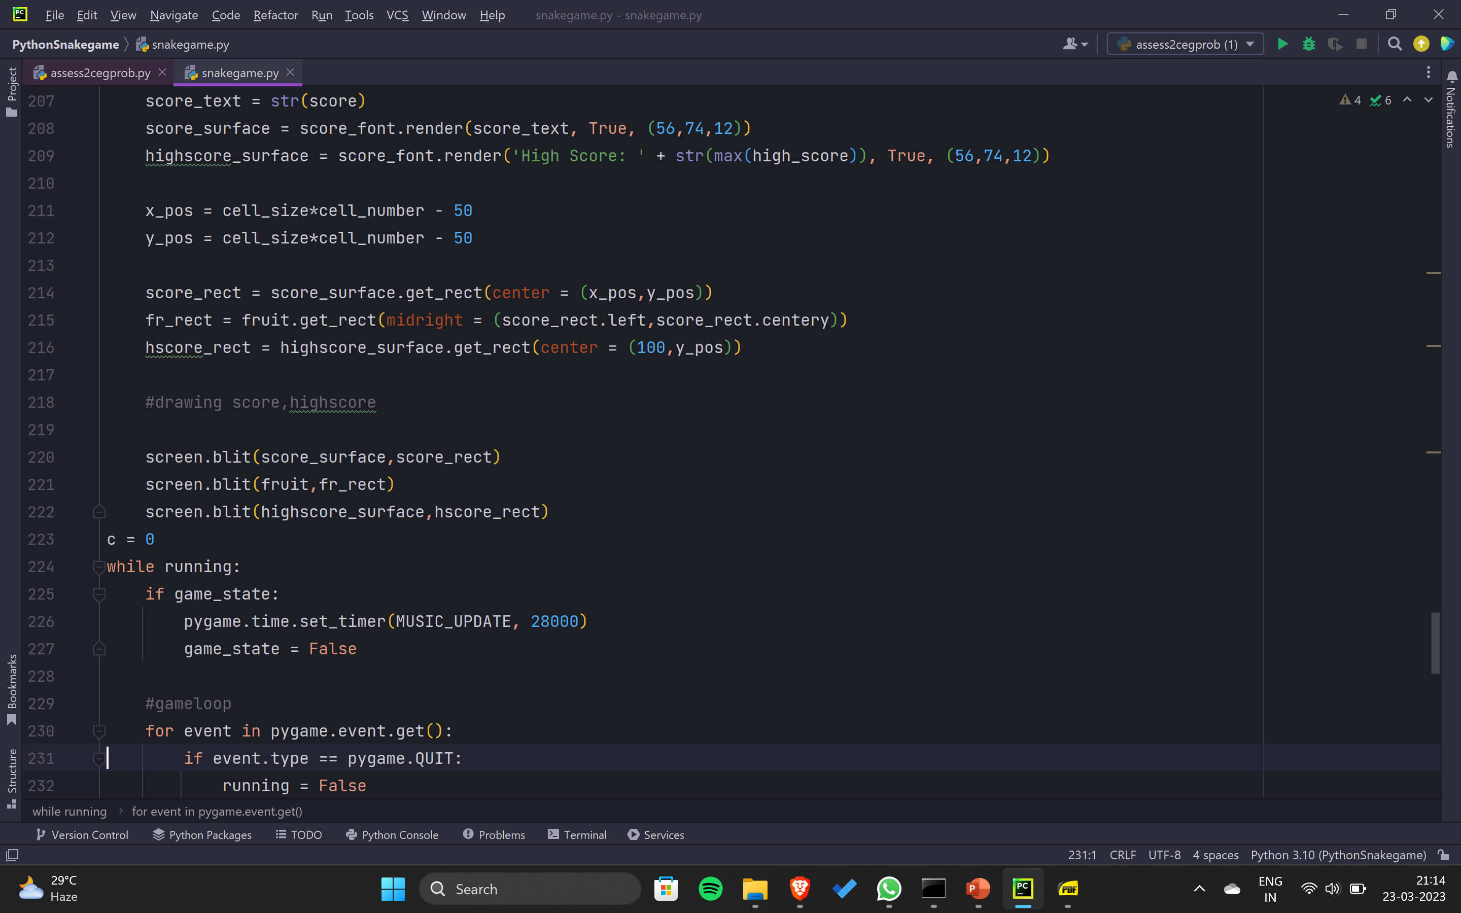
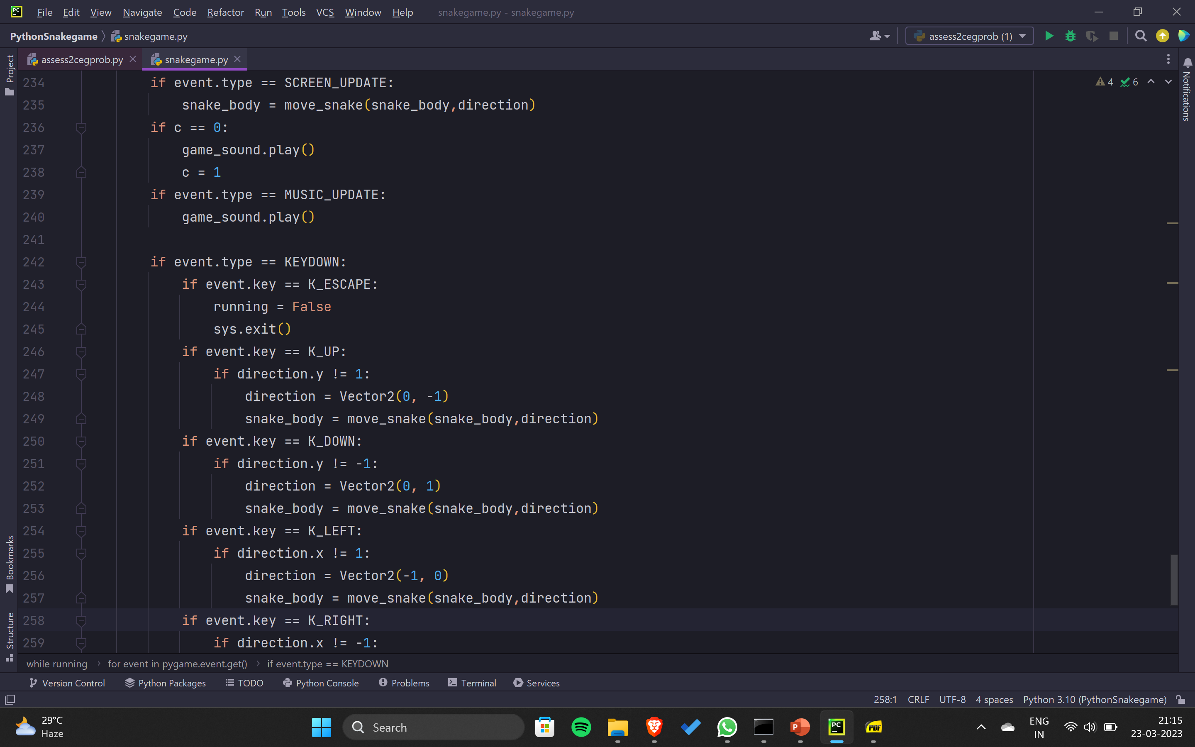

Slide 15
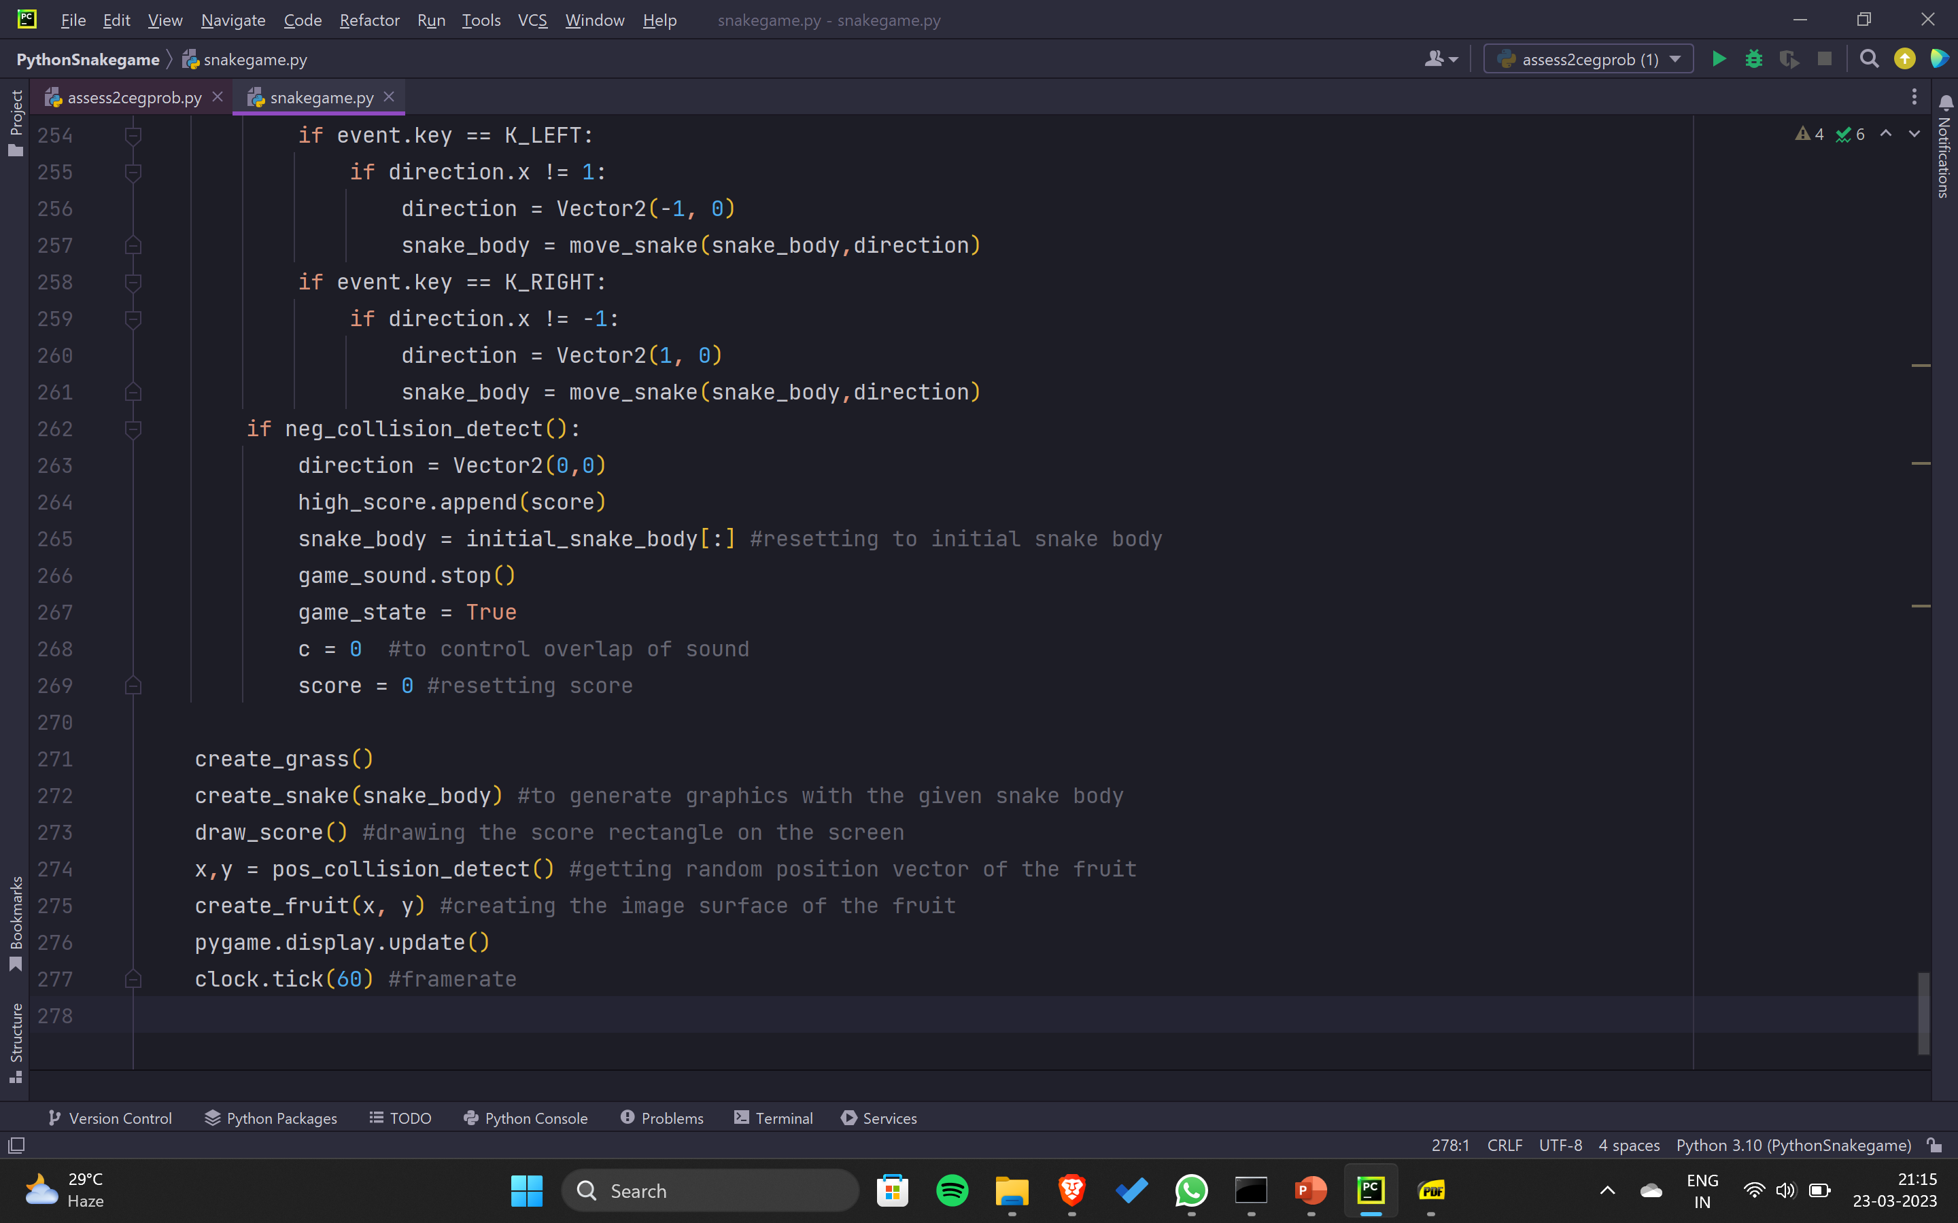

Slide 16
SAMPLE OUTPUT

Slide 17
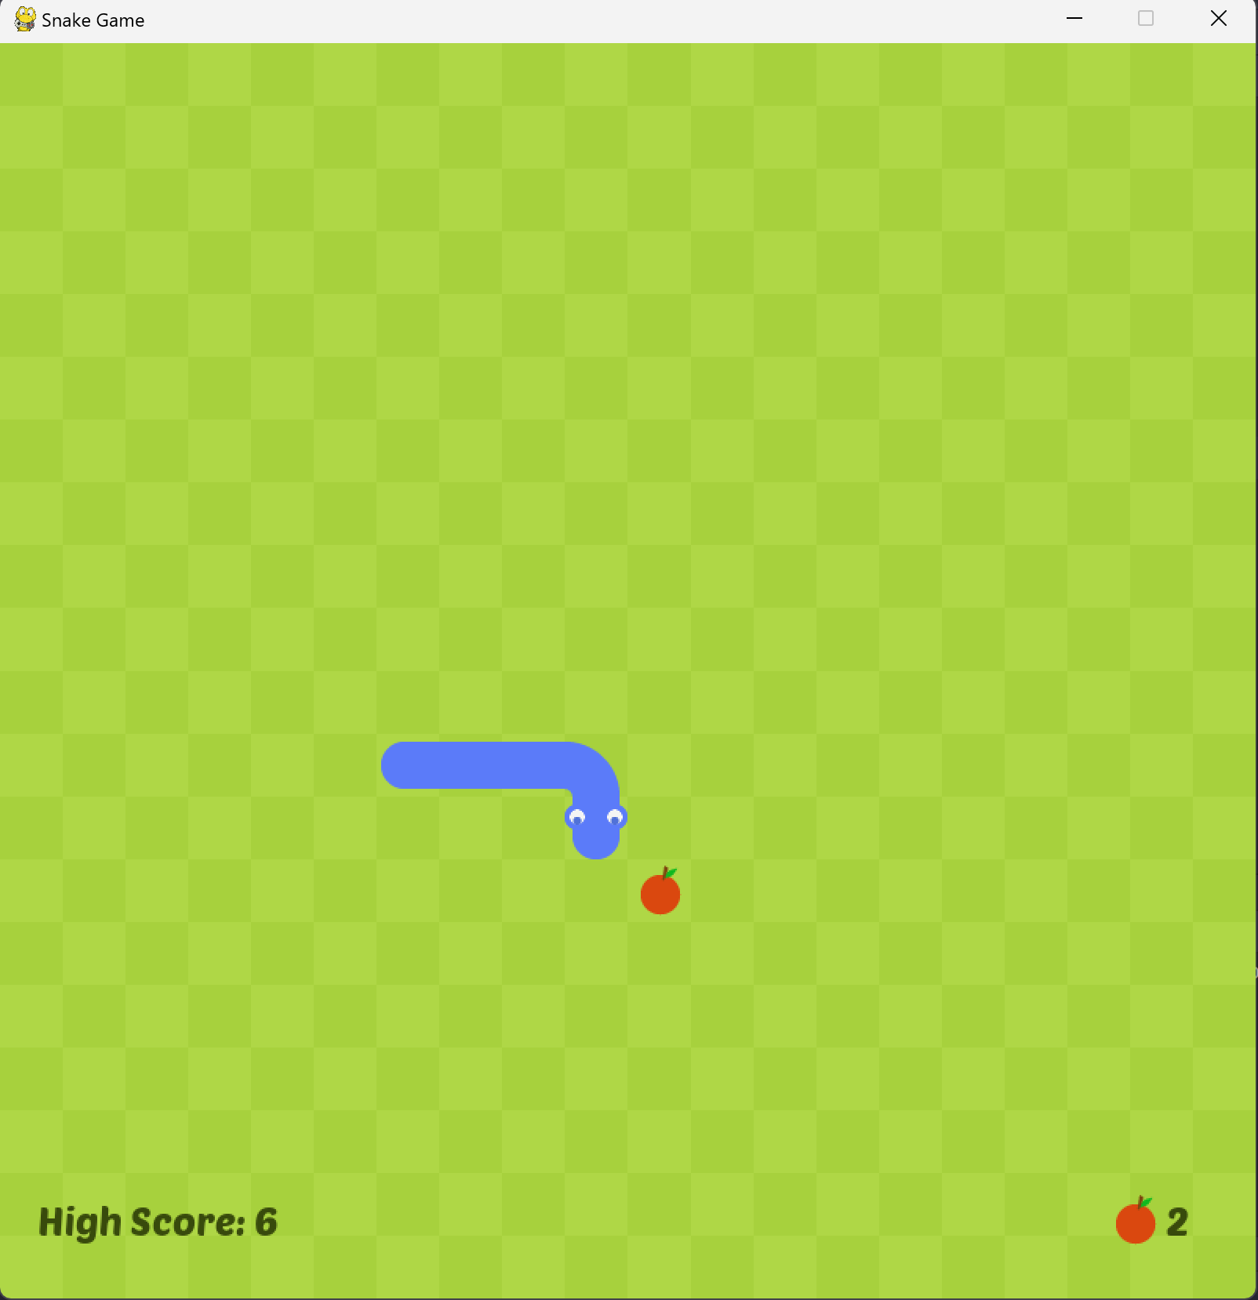
WHAT’S ON THE SCREEN ?
The screen is divided into square grids
each of which can be accessed by
vectors.
Snake body is simply the effect of
superposition of appropriate snake
image on each square grid.
The fruit image also shares the same
concept.
The bottom part of the screen contains
text surfaces for showing the score
and high score.
We have also added the classic snake
game track in the background. Every time
the snake collides with the fruit surface,
a crunch sound is played

Slide 18
CODE EXPLANATION
Functions that are derived from pygame module
User defined functions

Slide 19
METHODS AND ATTRIBUTES FROM PYGAME
Pygame.display:
Pygame.display.set_mode()
Pygame.display.set_caption()
Pygame.display.update()
Pygame.image:
Pygame.image.load()
Pygame.Surface.surface.convert_alpha()
Pygame.font:
Pygame.font.Font() #class
Pygame.font.Font.render()
Pygame.time:
Pygame.time.Clock() #class
Pygame.time.Clock.tick()
Pygame.time.set_timer()
Pygame.mixer:
Pygame.mixer.Sound() #class
Pygame.mixer.Sound.play()
Pygame.mixer.Sound.stop()
Pygame.rect:
Pygame.rect.Rect() #class
Other methods, classes and attributes used in our game:
Pygame.Surface.surface.blit()
Pygame.event.get()
Pygame.event.type and pygame.event.key
Pygame.Surface.surface.get_rect()

Slide 20
Pygame.display Pygame.image
Pygame is a Python library used for creating video games. Here are some key elements in Pygame.
Pygame.display: Used for creating and managing windows.
Pygame.display.set_mode() sets the size of the window
Pygame.display.set_caption() sets the window title
Pygame.display.update() updates the screen.
Pygame.image.load() loads an image
Pygame.Surface.convert_alpha() converts the image surface to a format that can be used with transparency. This makes pygame engine to handle with images efficiently.

Slide 21
Pygame.font Pygame.time
Used for creating and rendering text
Pygame.font.Font() creates a font object
Pygame.font.Font.render() renders the text onto a surface.
Used for tracking time
Pygame.time.Clock() creates a clock object that can be used to control the frame rate of the game
Pygame.time.set_timer() sets a timer to trigger an event at a specified time interval.
Pygame.time.Clock.tick() for controlling the frame rate of the game.

Slide 22
Pygame.mixer Pygame.rect
Used for playing and controlling sounds
Pygame.mixer.Sound() creates a sound object
Pygame.mixer.Sound.play()is used to start the music track.
Pygame.mixer.Sound.stop() is used ti stop playing the sound.
Used for working with rectangle objects in python. These are much convenient to handle than usual surfaces.
Pygame.rect.Rect() creates a rectangle object
Pygame.Surface.get_rect() returns a rectangle object representing the surface. It contains information about the position and dimensions of the surface.

Slide 23
Other methods, classes and attributes used in our game include
Pygame.Surface.blit() for drawing surfaces onto other surfaces.
Pygame.event.get() for getting events.
Pygame.event.type is for getting the type of event.
Pygame.event.key for key pressing events. If the event.type is KEYDOWN then this can be used to identify the type of key being pressed.

Slide 24
GAME LOOP
This is the main body of our code. The running variable determines the state of the game. If it is false then a quit event has occurred.
pygame.event.get() gets the current event’s identity. The for loops looks for any of the following events:
Quit event (closes the game if close button is clicked or escape key is pressed)
SCREEN_UPDATE event executes every 150ms. This simulates the movement of the snake
MUSIC_UPDATE event controls the background music. It gets executed every 28s (length of the music track).
KEYDOWN event determines if the key has been pressed. If it is pressed then we determine the type of the pressed key and we modify the direction variable accordingly.
Game resets whenever a negative collision has occurred.
Not only these, we also call few functions that we have mentioned in the upcoming slide in this area.
We have called update() method of the display class to update all the changes made to the screen and we have fixed the framerate of the game to 60hz using tick() function.

Slide 25
USER DEFINED FUNCTIONS
Functions:-
create_fruit(x,y)
create_snake(snake_body)
head_pos()
move_snake(body,direction)
pos_collision_detect()
neg_collision_detect()
create_grass()
draw_score()
tail_pos()

Slide 26
SOME DEFINTIONS BEFORE MOVING FORWARD
snake_body → List of vectors containing the position of each element of the snake body
screen → A 800px wide and 800px high screen (created using set_mode() function of the display class). We apply images and text surfaces over this screen.
cellsize and cellnumber → We have divided the screen into square grids each with 40px * 40px size. There are 400 such squares (20 every row and column).
score → maintains the score obtained by the player.
high_score → a list containing all the scores obtained by the user. The largest element of this list returns the high score.
direction → a vector2 object containing the direction in which the snake is moving.
game_state, c → variables that handle smooth play of the game sound.
Initial_snake_body → It is a clone of the snake body (a list of vectors) at the starting stage.

Slide 27
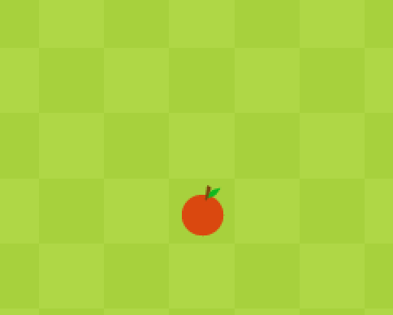
CREATING A FRUIT AT A RANDOM POSITION
create_fruit(x,y):
This function takes two parameters x and y which are random coordinates of the fruit.
Here, we have created a Vector2 object called pos to storage and retrieval of coordinate information
Then we have created a rectangle called fruit_rect object over the fruit image surface. This object contains information about the position of square grid and the size of the rectangle.
Finally, we blit (block transfer) the fruit image over the screen.

Slide 28
CREATING THE SNAKE
create_snake(snake_body):
This function helps to apply appropriate snake image over the snake rectangles. We simply fill each square of the grid with the snake image.
Snake body is divided into three parts:
Head
Body
Tail
We have looped over the each segment of the snake body (It is a list of vectors). If the index is
len(snake_body)-1 (last element) then we apply the snake head over it and if the index
is 0 then tail image added in all the other segments body image is added.
We have used the help of few auxiliary functions (tail_pos() and head_pos()) to apply the appropriate
image. We have used some vector calculations to determine turns in the body
NOTE: The upper y axis is negative and lower y axis is positive in pygame. x axis follow the usual trend

Slide 29
ADDING THE BODY IMAGE
There are two types of body images that we had to work on. Those are:
Vertical and horizontal body:
Finding if the snake is vertical or horizontal required us to find the vectors of the previous and the next body.
If the x component doesn’t change then the body is moving in vertical direction.
If the y component doesn’t change then the body is moving in horizontal direction.
Turning images:
Here also we have use the vectors of previous and next body.
We then determine the relationships between x and y coordinates of previous, current and the next body. With that information in hand we classified eight possible turns,
Bottom left and left bottom turn
Top left and left top turn
Top right and right top turn
Bottom right and right bottom turn

Slide 30




AUXILARY FUNCTIONS FOR CREATING THE SNAKE BODY
head_pos():
We have used vector subtraction to determine which direction the snake’s head is facing.
We have accomplished this by calculating the difference between the vector that is right before the head and the head vector . Depending upon any of the following results,
0İ-1j (head down image is added)
0i+1j (head up image is added)
1i+0j (head left image is added)
-1i+0j (head right image is added)
We add appropriate images from the right.

Slide 31




AUXILARY FUNCTIONS FOR CREATING THE SNAKE BODY
tail_pos():
Again we use some clever vector calculations to find the appropriate snake tail that we should apply over the rectangle.
We subtract the current vector and the previous vector. Depending upon the following results,
0i-1j (Tail down image)
0i+1j (Tail up image)
1i+0j (Tail left image)
-1i+0j (Tail right image)
we add the appropriate tail images from the right.

Slide 32
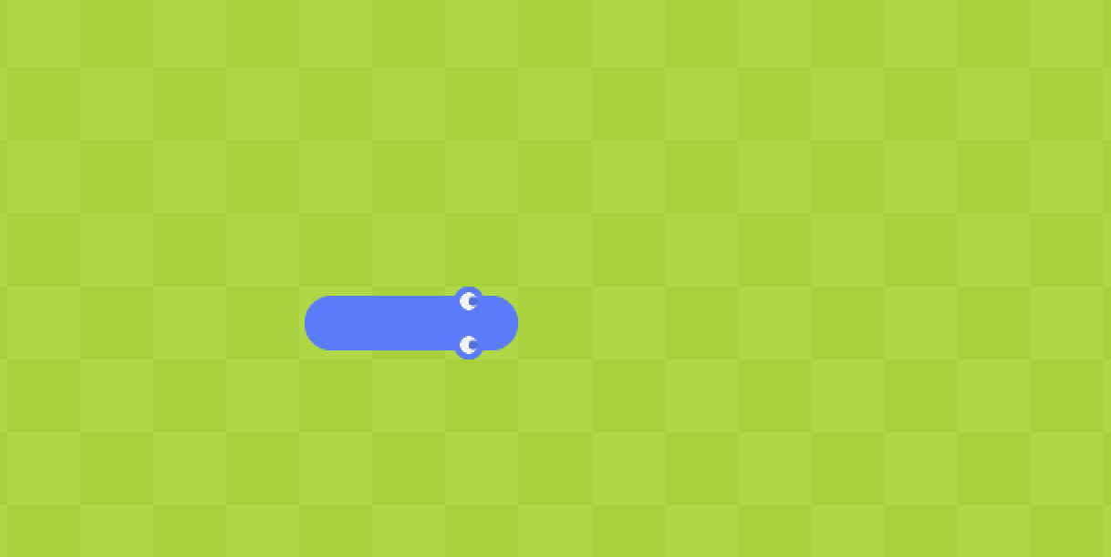
MOVING THE SNAKE
move_snake(body, direction):
body → list of snake body vectors.
direction → vector representing the direction in which the snake is moving.
We have created an event called SCREEN_UPDATE that runs every 150 milliseconds. This automatically calls the move_snake() function every 150ms.
The key down events change the direction vector of the snake.
We take every element of the snake body except the head element and assign the vector of the next snake body to the current element.
We change the value of head vector by adding to it the direction vector.
These actions cumulatively moves the snake in the given direction
NOTE: We can technically control the speed of the snake movement by increasing or decreasing the time in set_timer() method of the SCREEN_UPDATE event

Slide 33
FUNCTIONS TO HANDLE COLLISIONS
We have divided the collision into two types. Those are,
Positive collisions (When the snake collides with the fruit)
Negative collisions (When the snake collides with itself or the end of the screen)
Collision is an important part of our game. These functions, in a way, carry our entire game logic.
#Anselm → add collision images

Slide 34
POSITIVE COLLISIONS
pos_collision_detect():
This function is a pivotal function in our game. This handles three things simultaneously. Those are,
Score handling.
Randomising the fruit location and playing crunch sound whenever the snake collides with the fruit.
Incrementing the size of the snake by whenever it hits a fruit.
Whenever the snake collides with the fruit, value of the score variable is incremented by one.
We also have to play eating sound which is simply implemented by eating_sound.play().
If the snake is moving in y direction (vertical direction) then we insert a new vector to the beginning of the list. This new vector is obtained by adding 0i+1j (down) to the tail vector.
If the snake is moving in x direction (horizontal direction) then we add -1i+0j (left) to the tail vector and the resultant is inserted to the beginning of the list.
Finally, we have returned the new random coordinates of the fruit.

Slide 35
NEGATIVE COLLISIONS
neg_collision_detect():
There are two conditions to identify if a negative collision is occurred. Those are,
Position of the snake head is not within the screen.
Snake head collides with its own body
As explained before, there are 20 squares in each and every row and column. If the snake head is not present between the first (0th square) or the last square (19th square) in that row or column then a negative collision is registered.
If snake head’s position is same as any one of the other body elements then also a negative collision is registered.
If neg_collision_detect() returns true then direction vector is reset to 0i+0j and the snake body takes the value of initial snake body (representing fresh game state). Game sound is stopped and will be played if the player presses one of the arrow keys to move the snake.

Slide 36

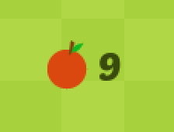
DISPLAYING SCORE AND HIGH SCORE
draw_score():
We have created three objects that are to be blitted over the screen. Those are,
Score surface : This displays the current score.
High score surface : This displays the highest score obtained by the player.
Fruit rectangle : This puts a fruit image before the score surface for visual context.
These surfaces are created by render() method of the Font class. render() method contains information about font colour and text. We have also turned anti aliasing on for smoothness of text.
We have created score_rect to hold the position and size data of the score surface and a h_score and fr_rect to hold the position and size data of the high score and the fruit surface respectively.
All these are transferred to the screen by calling blit() method.

Slide 37

CREATING THE GRASS PATTERN
create_grass():
We have used two colours for creating the grass pattern,
Light green colour (RGB : (167,209,61))
Dark green colour (RGB : (175,215,70))
For every odd row, we colour the square by dark green if the column is even else we colour it by light green.
For every even row, we colour the square by light green if the column is even else we colour it by dark green.

Slide 38
ANSELM
Align all the text in the above slides. Find a way to shift the bullet points to the left.
Use courier new font (I have used corbel font pls change them ☺) for functions and variables from our code.
Outcome slide and thank you slide.

